Slide 2
A CIO’s view of SDN
Who are REANNZ
Current Maturity of SDN (top-down)
Adoption and Use Cases
Barriers to Adoption
Challenges to overcome & Community Support
What REANNZ are doing

Slide 3
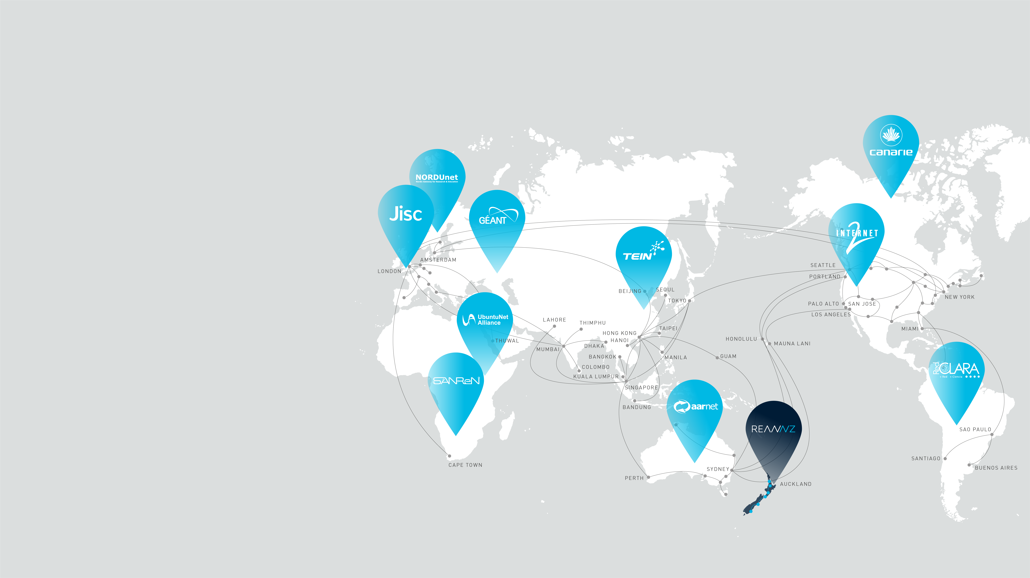
Collaboration and partnership on this scale requires network capacity, high-performance, reach and flexibility. These are fundamental features offered by REANNZ and 117 other national research and education networks around the world.
Universities in NZ need a specialist network
Notes:
Collaboration and partnership on this scale requires network capacity, high performance, reach and flexibility. These are the features offed by REANNZ and the 117 sister networks like ours around the world.
This global partnership of networks provides NZ with access to a global express-path for research and education.

Slide 4

International partnerships
Infrastructure Strategy
Partner and co-invest to gain access to instruments and other research infrastructure that individual institutions or NZ simply can’t afford on its own
eg Synchrotron, Large Hadron Collider, Genomics infrastructure, Compute
International collaboration in research
Access to global talent, building NZ’s reputation
Minister Goldsmith, 22 March 2017
4
Notes:
The governments science strategy is dependent on building international partnerships, both to ensure NZ has access to instruments and other infrastructure that we simply can’t afford to create on our own, and also to encourage collaboration in research and education itself.

Slide 5
A CIO’s view of SDN
New technologies and movements all start somewhere and in the case of SDN the technical aspects have largely preceded the business buy in.
As a result there is a lot of misunderstanding among the CIO/Exec community as to what SDN is (and isn't), what the benefits are and how those benefits can be realised.
Funding and application of resource is an issue (definitely in NZ) that needs to be viewed not only from the technical R&D aspect but also how you can successfully gain buy in from the executive.

Slide 6
Current maturity

Slide 7
Top Down view of SDN Maturity
Sounds like a great idea but not well understood in senior levels.
Can be dismissed as another “Buzzword”
Primarily look at SDN infrastructure as a Silver Bullet
E.g. automation = cheaper/less staff
Lots of technical opinions further confused by commercial providers
It is hard to describe a “Movement”
Control plane benefits (elastic scaling, agile provisioning, JIT deployments, resilience, etc.) need to be realised.
You need tangible applications and you need to talk about them
Notes:
I tend to talk about Software “Enhanced” Networking rather than SDN
I don’t believe that if you are already running fairly lean that team size will change - just the things that are currently manual will become less painful and your engineers will be able to focus their energies on different things.
This has now got visibility so there is focus from all areas – forums like this need to help manage the message

Slide 8
Adoption and use cases

Slide 9
The need for business planning & use cases
No one wants to go first (but that is changing)
There is spend required both in people time and infrastructure. This needs to be built into Business Planning
Run simultaneously to prove concept
Infrastructure refresh
Greenfields
You won’t get the $$ if you have not got a Tangible Use Case
Proving takes time
Exec need to understand the value of SDN (e.g. WAN or the DC)
Notes:
Trying to articulate the differences that can be achieved is one thing but then trying to secure funding is another
Timing is everything
At REANNZ we have had several years of involvement in Faucet, we run it for our internal network but trying to articulate value to the exec and board has been difficult

Slide 10
Barriers to adoption

Slide 11
Barriers that slow us down
Proof Of Value (automation, quality, risk)
Available funding for an unproven approach
Lack of leadership & support at the right places
Low Digital Fluency, need to bring the argument up from technical
Impact on current roles & other Cultural Factors
Current process & infrastructure. Time & $ to make a change.
Notes:
Some things you can do by stealth – it is far easier to ask forgiveness than seek permission
Communities such as these are vitally important for moving forward in a positive way
Need to not only manage the technical conversation but also the potential impacts on the business, the people, the culture. Need to think about the difference genuine adoption of this technology will make to your teams and the skills that they need. REANNZ technical teams joined

Slide 12
Challenges to overcome & Community support

Slide 13
Marketing & funding
Need to provide a clear & concise explanation of what SDN is at a Business Level i.e. improved quality and response times rather than control plane & elastic networks.
Make the message Consumable By Everyone
Real World Applications
Operational Efficiency & Resiliency
Not always less people or even OPEX BUT Better Service, Better Quality, Flexiblilty

Slide 14
What reannz are doing

Slide 15
What reannz are doing
Participating in the wider SDN Community
Attend & speak at events such as FaucetCon
Support local events such as NZNOG/NetHui/etc.
Faucet Foundation
Assign a portion of R&D budget to focused SDN related activity for REANNZ to further our own work and that of the community
Active engagement with vendors
Being Visible

